Slide 1
Telecom Industry - What influences customers to churn?
Prakash Kumar
Springboard

Slide 2
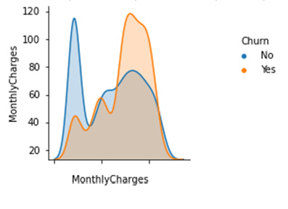
Charges?
Yes – People paying higher monthly charges tend to churn more.

Slide 3
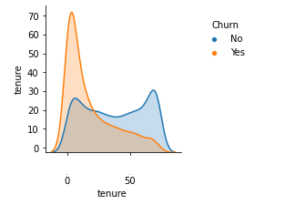
longer CONTRACT?
No – People on longer contract seem to be more loyal.

Slide 4
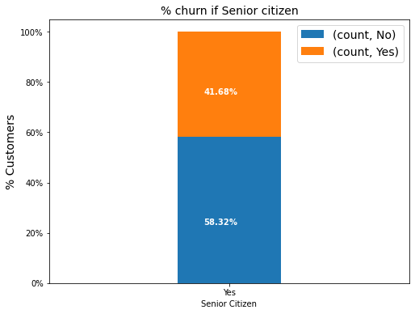
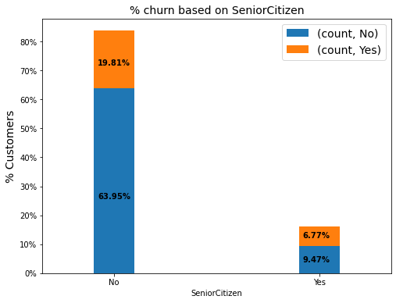
Who Tends to be MORE LOYAL – OLD/Young

Slide 5
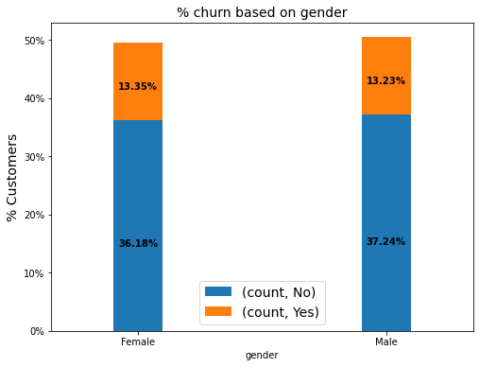
What About Gender?
Gender does not seem to be a deciding factor.

Slide 6
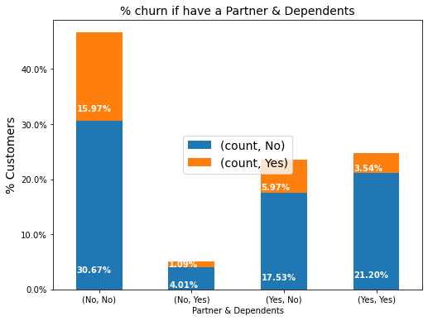
DO People with Family Tend to Churn More?
Its opposite – People settled in their personal life seem to be settled on your network too.

Slide 7
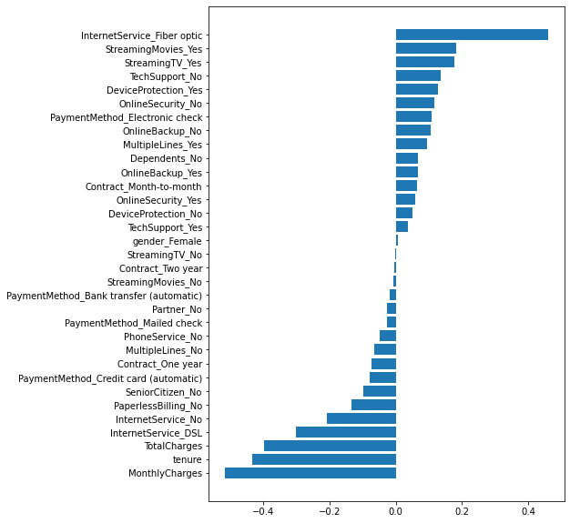
What SHOULD BE THE FOCUS TO MAKE THEM STICK?
Improve upon cost.
Incentivize longer contracts
Improve Internet and Internet-based services such as streaming and content.
Target singles with more attractive offers.

